Slide 1

Interactive Storytelling with GPT-2
TEXT GENERATION WITH HUGGING FACE
Notes:
Welcome to our lesson on using Hugging Face text-generative Transformer Models for Interactive Storytelling - a lesson that will help you learn how to use text generation models to create engaging interactive fiction and digital storytelling experiences.

Slide 2
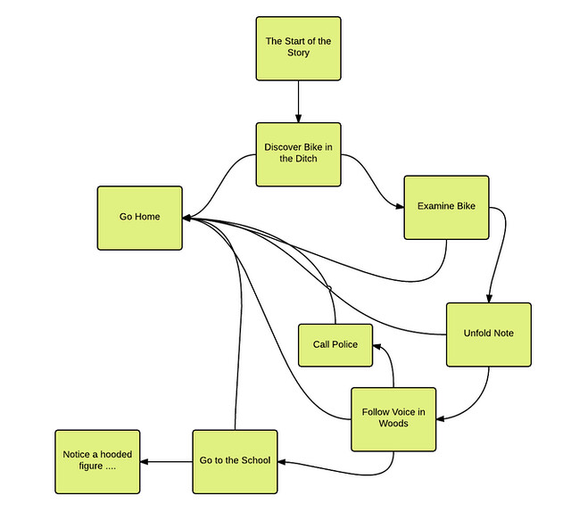
What about interactive stories?
Text generation models that respond to the user as the story progresses.
Create interactive fiction and digital storytelling experiences.
Apply text generation in interactive environments, such as gaming.
Use models to emphasize narrative coherence and user engagement.
Notes:
We can put such a model to effective and imaginative use for creative writing, providing inspiration, and assisting with content generation. Behold! a powerful tool in the realm of natural language processing and the toolkit of a content or story writer.
Let’s continue to explore the application of text generation models in interactive fiction and game environments.
You might be wondering what this means? Interactive fiction is a type of digital storytelling where the reader or player makes the choices that influence the direction and outcome of the story. This creates a unique and engaging experience, as the story changes and adapts around your decision.

Slide 3
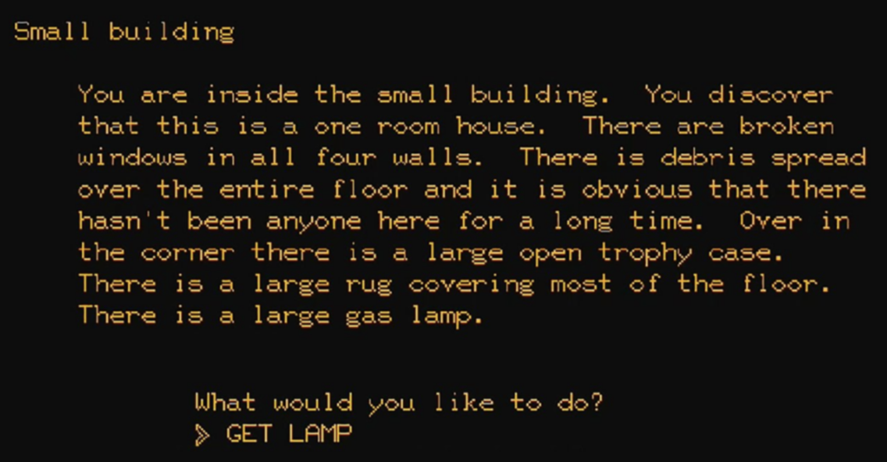
Notes:
Here is an example of a text-based story that progresses based on your decisions. But what is the limitation? I only have one option and, whilst I am sure the story is riveting, this point-and-click game cannot really interact with me and adapt based on my choices.

Slide 4
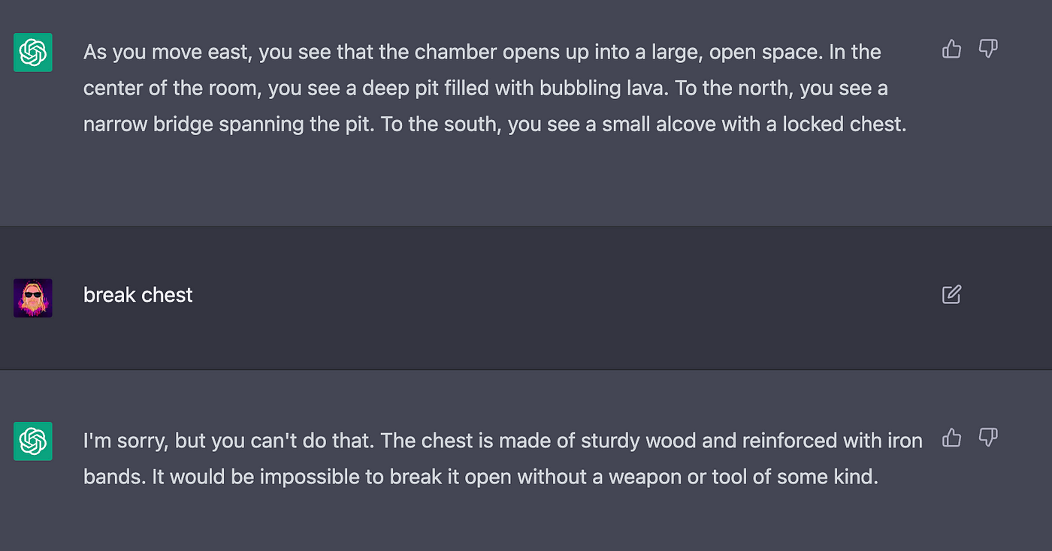
Notes:
Now this is a little more like it - it certainly looks familiar, no? Text generation can already be achieved with ChatGPT, for example, to generate story content based on user input. This definitely offers potential for more flexible and personalized narratives, but as you can see above, this does not guarantee fun, engaging, and adaptive storytelling. The answer given by ChatGPT could hardly be described as dynamic. Can we get these models to adapt story arcs by generating real-time content?

Slide 5
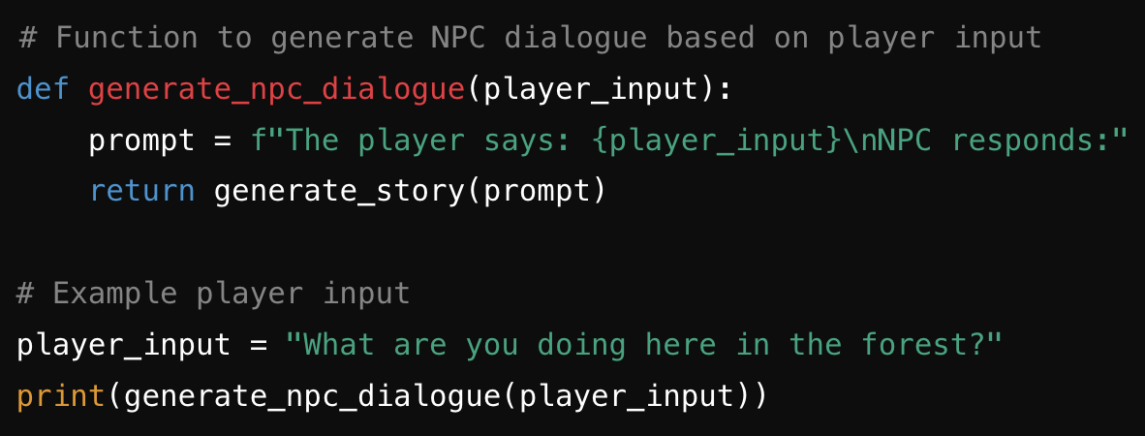
NPC 1 responds: "I am gathering moonlight to weave a cloak of dreams. It's a delicate task that requires utmost precision and silence. Do you wish to help?"
NPC 2 responds: "Oh, just having a tea party with the talking mushrooms. Would you care to join? They tell the most delightful stories about the underground realms."
NPC 3 responds: "I am the guardian of the ancient whispers, collecting the secrets of the trees. Each leaf holds a story from another world. Can you hear them?"
Notes:
Engaging users in interactive fiction involves creating compelling choices and ensuring that their decisions have meaningful consequences. This keeps users invested in the story. One example would be in-world characters that change, develop, grow, and adapt to you, the character, as you move through the storyline and wider world.
Text generation can be integrated into gaming environments to create dynamic storylines and responsive NPC dialogues, which would enormously enhance the depth and immersion of the game. No two conversations would be the same and, with some extra fiddling and game design, an ordinary NPC would live out a developing storyline of their own.

Slide 6
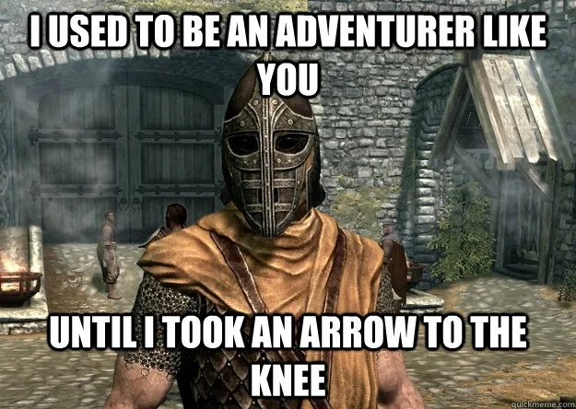
Notes:
Just imagine! We will finally be able to ask this infamous (and unfortunate) guard how he came to receive a sharp projectile through his leg joint, which ended his gallivanting adventures through the lands of Skyrim.

Slide 7
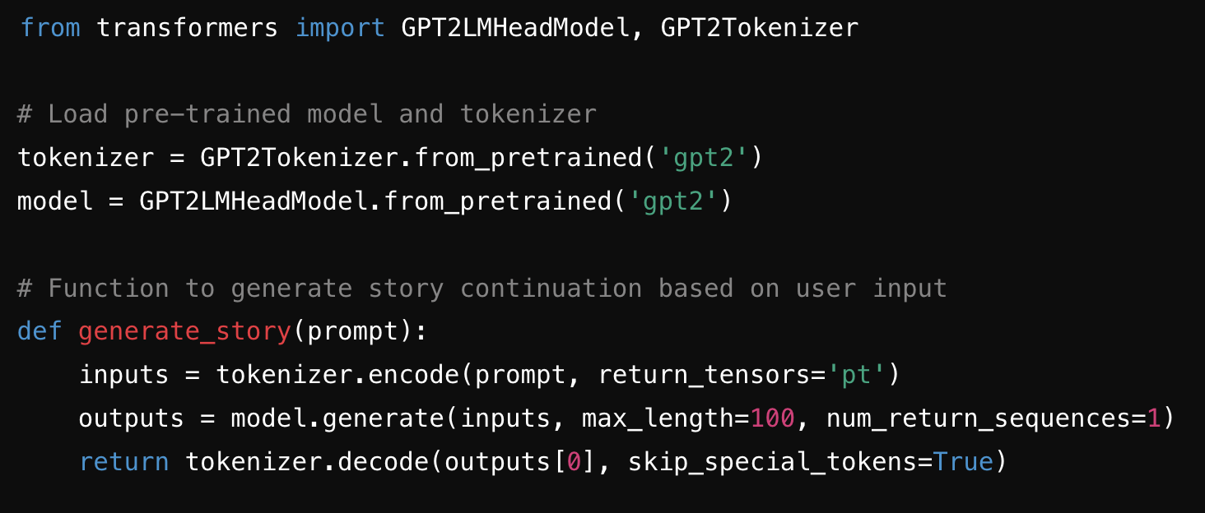
Notes:
Maintaining narrative coherence is crucial in interactive fiction. The generated text must logically follow from previous text and user choices to create a seamless storytelling experience.
The following code is a simple interactive story generator using a pre-trained GPT-2 model from the `transformers` library. Here’s a breakdown:
Firstly, we import and load the pre-trained GPT2LMHeadModel (the model) and GPT2Tokenizer (the tokenizer).
Secondly, we define a generate_story function to - you guessed it - generate a story based on a prompt.
Within this function, we need to encode the input prompt using the tokenizer and instruct the model to generate text.
Finally, our story-generating function decodes the generated output and returns it as human-legible text.
1. **Import Libraries**: It imports the necessary modules from the `transformers` library.
2. **Load Pre-trained Model and Tokenizer**: The GPT-2 tokenizer and model are loaded using `from_pretrained('gpt2')`.
3. **Define Function to Generate Story Continuation**: A function `generate_story` is defined to generate a continuation of a given prompt using the GPT-2 model.
- It encodes the input prompt.
- It generates the continuation using the model.
- It decodes the generated output back into text.
4. **Initial Story Prompt**: An initial story prompt is defined.
5. **Print Initial Prompt and Generated Story**: The initial prompt is printed, and the generated continuation is displayed.

Slide 8
Initial Prompt:
“You find yourself in a dark forest. Suddenly, you hear a noise behind you. Do you turn around or keep walking?”
User Reply:
“I’m going to turn around and face whatever danger awaits with a sword in my hand and a death song on my lips.”
Responsive AI Reply:
“You decide to turn around and face whatever is making the noise. As you slowly pivot, you catch a glimpse of a shadow darting between the trees. Your heart races, but you muster up the courage to call out, "Who's there?" The forest remains silent, but you feel a presence watching you. You take a cautious step forward, your eyes scanning the darkness for any signs of movement.”
Notes:
Here it is, the next step of the generated story.
But what is missing? Is our story over? We didn’t even get to fight the trolls and dragon!
Not to worry, young NLP-squire - the story is not over yet!

Slide 9
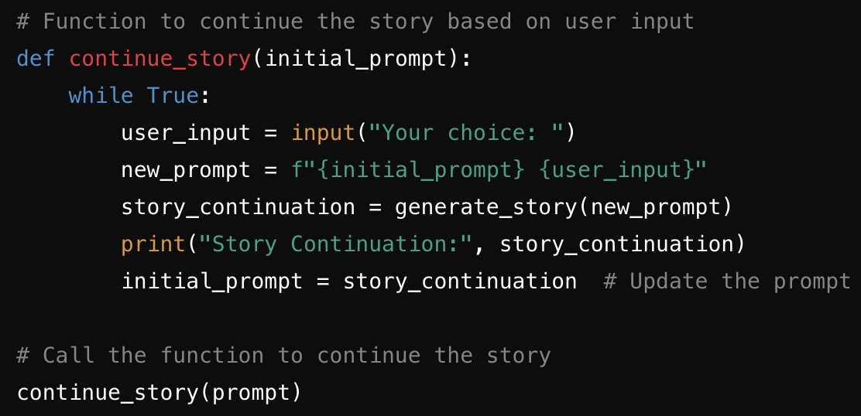
Notes:
A function `continue_story` is defined which allows you, the user, to continue the interactive story.
Here is a breakdown:
we create an infinite loop with ‘while True’ and request input;
thanks to the magic of our pre-trained transformer model, a new prompt can be generated;
the user input is appended to the existing story;
the new story prompt is generated, and the continuation is displayed;
finally, the story prompt is updated with the new continuation.

Slide 10
Your choice: Investigate the shadow.
Story Continuation: You move towards the direction where the shadow disappeared. The trees seem to close in around you, and the air grows colder. Suddenly, you stumble upon a clearing where a small, abandoned cabin stands. The door creaks open as if inviting you in. What happens next?
Your choice: I gird my loins and throw caution to the wind. I explore the cabin.
You hesitate for a moment, but curiosity gets the better of you. As you step inside, the floorboards groan under your weight. Dust particles dance in the beam of your flashlight, revealing old furniture and forgotten memories. Do you keep going?
Your choice: Onwards to death or victory!
Story Continuation: Very nice. You cautiously walk through the cabin, your footsteps echoing in the empty space. In the corner of the room, you notice a trapdoor partially hidden under a rug. With a deep breath, you pull the rug aside and lift the trapdoor. A ladder leads down into a dark basement. What do you do?
Your choice: I want to go down the ladder and plunge into depths of darkness.
Story Continuation: Your flashlight flickers as you descend, revealing a hidden room filled with strange artifacts and ancient books. One book, in particular, catches your eye – its cover adorned with mysterious symbols that seem to glow in the dim light. What action do you take?
Notes:
In this lesson, you learned that GPT-2 is a powerful language model that can be harnessed for various applications. Indeed, the ‘off the shelf’ version is well within reach of the average coder - with a little learning, you have access to such a powerful tool.
You now know that GPT-2 is a state-of-the-art language model that generates text based on given prompts. In your next lesson, you will explore how fine-tuning parameters allow greater control over the generated text.
We’ve discussed use cases for text-generation with pre-trained transformer models, which range from creative writing to chatbots and data augmentation.
You have also explored how they can significantly enhance interactive fiction and storytelling with dynamic and engaging narratives. By maintaining coherence and user engagement in your story, you (the author) can begin to create immersive experiences.

Slide 11
Let’s practise!
TEXT GENERATION WITH HUGGING FACE
Notes:
Now it's your turn! Use the provided code to practise importing an ‘off the shelf’ GPT-2 model and generating your own text and interactive stories. Experiment with different user inputs and observe how they influence the narrative.

